Slide 1
Artificial
Intelligence and Machine Learning
“House Price Prediction”
Team Member and Roll No.
Neeshu - 2210990603
Nandini - 2210990597
Muskan – 2210990588
Faculty Coordinator: Ms Monica Dutta
Department of Computer Science and Engineering
Chitkara University Institute of Engineering & Technology,
Chitkara University, Punjab

Slide 2
TABLE OF CONTENT
Abstract
Introduction
Problem Statement
Brief about House Price Prediction
Objectives
Dataset Overview
Flow Chart
Tools and technologies
Result
Future scope
Conclusion
Reference

Slide 3
ABSTRACT
Data mining is widely employed in the real estate market due to its ability to extract relevant information from raw data for predicting house prices and identifying important housing features.
Fluctuations in housing prices, often influenced by various factors, necessitate effective prediction models to aid homeowners and stabilize the housing market.
Literature review highlights the significance of analyzing relevant factors and selecting appropriate models for predicting housing prices.
The study affirms the effectiveness of Artificial Neural Network, Support Vector Regression, and Linear Regression models in predicting house prices compared to other models.
Key factors identified for predicting house prices include spatial variables and the influence of real estate agents.

Slide 4
INTRODUCTION
The real estate market sees thousands of house sales daily, prompting questions about fair pricing.
This paper proposes developing a machine learning model to predict house prices based on various house-related data.
The approach includes providing code and outputs for each step to ensure reproducibility.
The proposed machine learning model will leverage data such as house size, construction year, and other relevant factors to enhance price prediction accuracy.
With transparency and reproducibility as core principles, the study will showcase the code and outputs of each model development and evaluation step.
Through the utilization of Python programming language and its associated packages, the study ensures a robust and accessible methodology for predicting house prices.

Slide 5
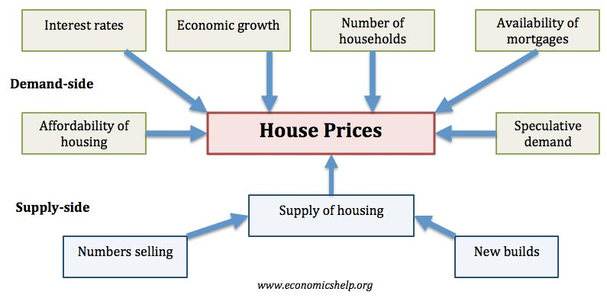

Slide 6
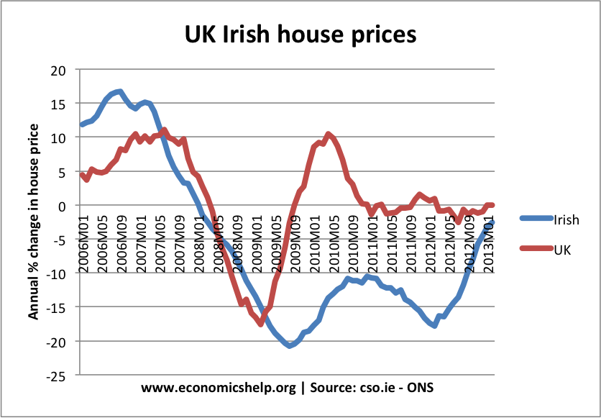

Slide 7
PROBLEM STATEMENT
Real estate listings often separate standardized characteristics from the asking price and general description, facilitating easy comparison across potential houses.
Unique features of each house, such as a specific view or type of sink, are summarized in the description but pose challenges for automated comparison due to their diversity.
Housing prices reflect economic conditions, and price ranges are of significant interest to both buyers and sellers.
The project aims to predict house prices using explanatory variables covering various aspects of residential houses.
The goal is to develop a regression model capable of accurately estimating house prices based on their features.

Slide 8
BRIEF ABOUT HOUSE PRICE PREDICTION
Linear Regression : LR is a supervised ML technique used for regression tasks, where it operates under the assumption of a linear connection between an input variable (x) and a solitary output variable (y). By incorporating multiple independent features from our dataset.
Random Forest Regression : RF is like a team of models working together to make more accurate predictions. Instead of relying on just one model, it combines multiple models to create a stronger and more reliable model.
Decision Tree Forest Regression : DT is a powerful algorithm used in machine learning for making predictions. It operates by constructing a tree-like model of decisions allowing for a diverse set of decision trees to be created.
Neural Networks : Neural Networks are computational models that mimic the complex functions of the human brain. The neural networks consist of interconnected nodes or neurons that process and learn from data, enabling tasks such as pattern recognition and decision making in machine learning.

Slide 9
OBJECTIVE
Economic growth: Demand for housing is dependent upon income. With higher economic growth and rising incomes, people will be able to spend more on houses; this will increase demand and push up prices.
Unemployment: Related to economic growth is unemployment. When unemployment is rising, fewer people will be able to afford a house. But, even the fear of unemployment may discourage people from entering the property market.
Interest rates: Interest rates affect the cost of monthly mortgage payments. A period of high- interest rates will increase cost of mortgage payments and will cause lower demand for buying a house.
Consumer confidence: Confidence is important for determining whether people want to take the risk of taking out a mortgage. In particular expectations towards the housing market is important; if people fear house prices could fall, people will defer buying.
Supply: A shortage of supply pushes up prices. Excess supply will cause prices to fall. For example, in the Irish property boom of 1996-2006, an estimated 700,000 new houses were built.

Slide 10
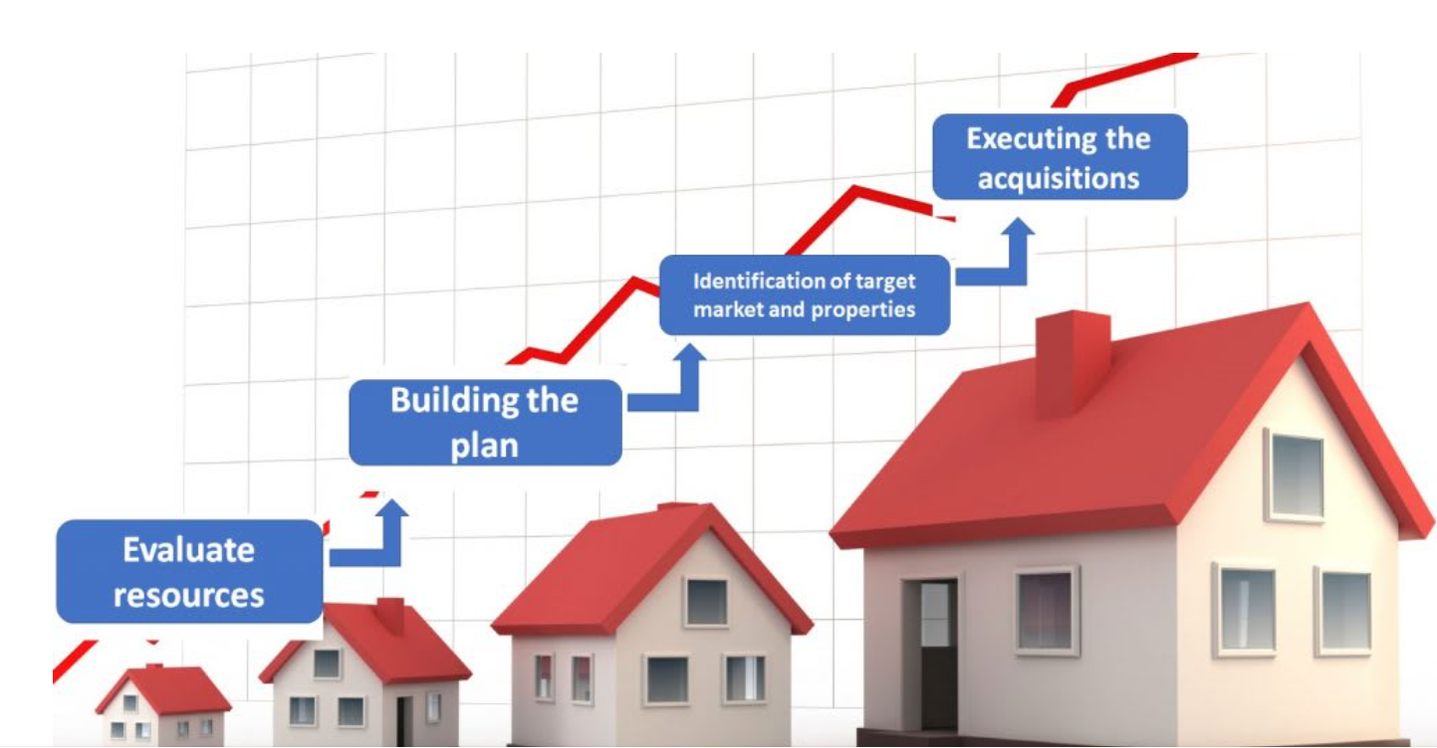

Slide 11
DATA OVERVIEW
The dataset serves as the foundation for predicting house prices in the project.
It provides a comprehensive overview of various factors influencing house prices.
Each observation in the dataset represents a specific residential property the dataset contains a mix of nominal, ordinal, discrete, and continuous variables.
The dataset likely requires preprocessing to handle missing values, outliers, and feature engineering for model training.
Exploratory data analysis (EDA) techniques are likely employed to gain insights into the relationships between variables and the target variable (house prices).
Understanding the dataset's characteristics and distributions is crucial for building accurate predictive models.
The dataset serves as the backbone for training and evaluating machine learning models aimed at predicting house prices effectively.

Slide 12
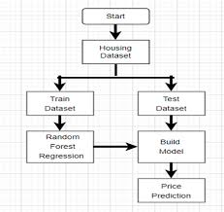
FLOW CHART

Slide 13
TOOLS AND TECHNOLOGIES
Hardware Requirements: The most common set of requirements defined by any operating system or software application is the physical computer resources, also known as hardware. PROCESSOR PENTIUM IV
RAM: 8 GB
PROCESSOR: 2.4 GHZ
MAIN MEMORY: 8GB RAM
PROCESSING SPEED: 600 MHZ
HARD DISK DRIVE: 1TB
KEYBOARD :104 KEYS
Software Requirements: Software requirements deals with defining resource requirements and prerequisites that needs to be installed on a computer to provide functioning of an application. These requirements are need to be installed separately before the software is installed. The minimal software requirements are as follows:
FRONT END: PYTHON
IDE: ANACONDA
OPERATING SYSTEM: WINDOWS 10

Slide 14
Software Requirements : Software requirements deals with defining resource requirements and prerequisites that needs to be installed on a computer to provide functioning of an application. These requirements are need to be installed separately before the software is installed. The minimal software requirements are as follows:
FRONT END: PYTHON
IDE: ANACONDA
OPERATING SYSTEM: WINDOWS 10
2.4 Feasibility Features : The feasibility of the project is analyzed in this phase and business proposal is put forth with a very general plan for the project and some cost estimates. The feasibility study of the proposed system is carried out. It is carried out to ensure that the proposed system is not a burden to the company.
Economic feasibility
Technical feasibility
Social feasibility

Slide 15
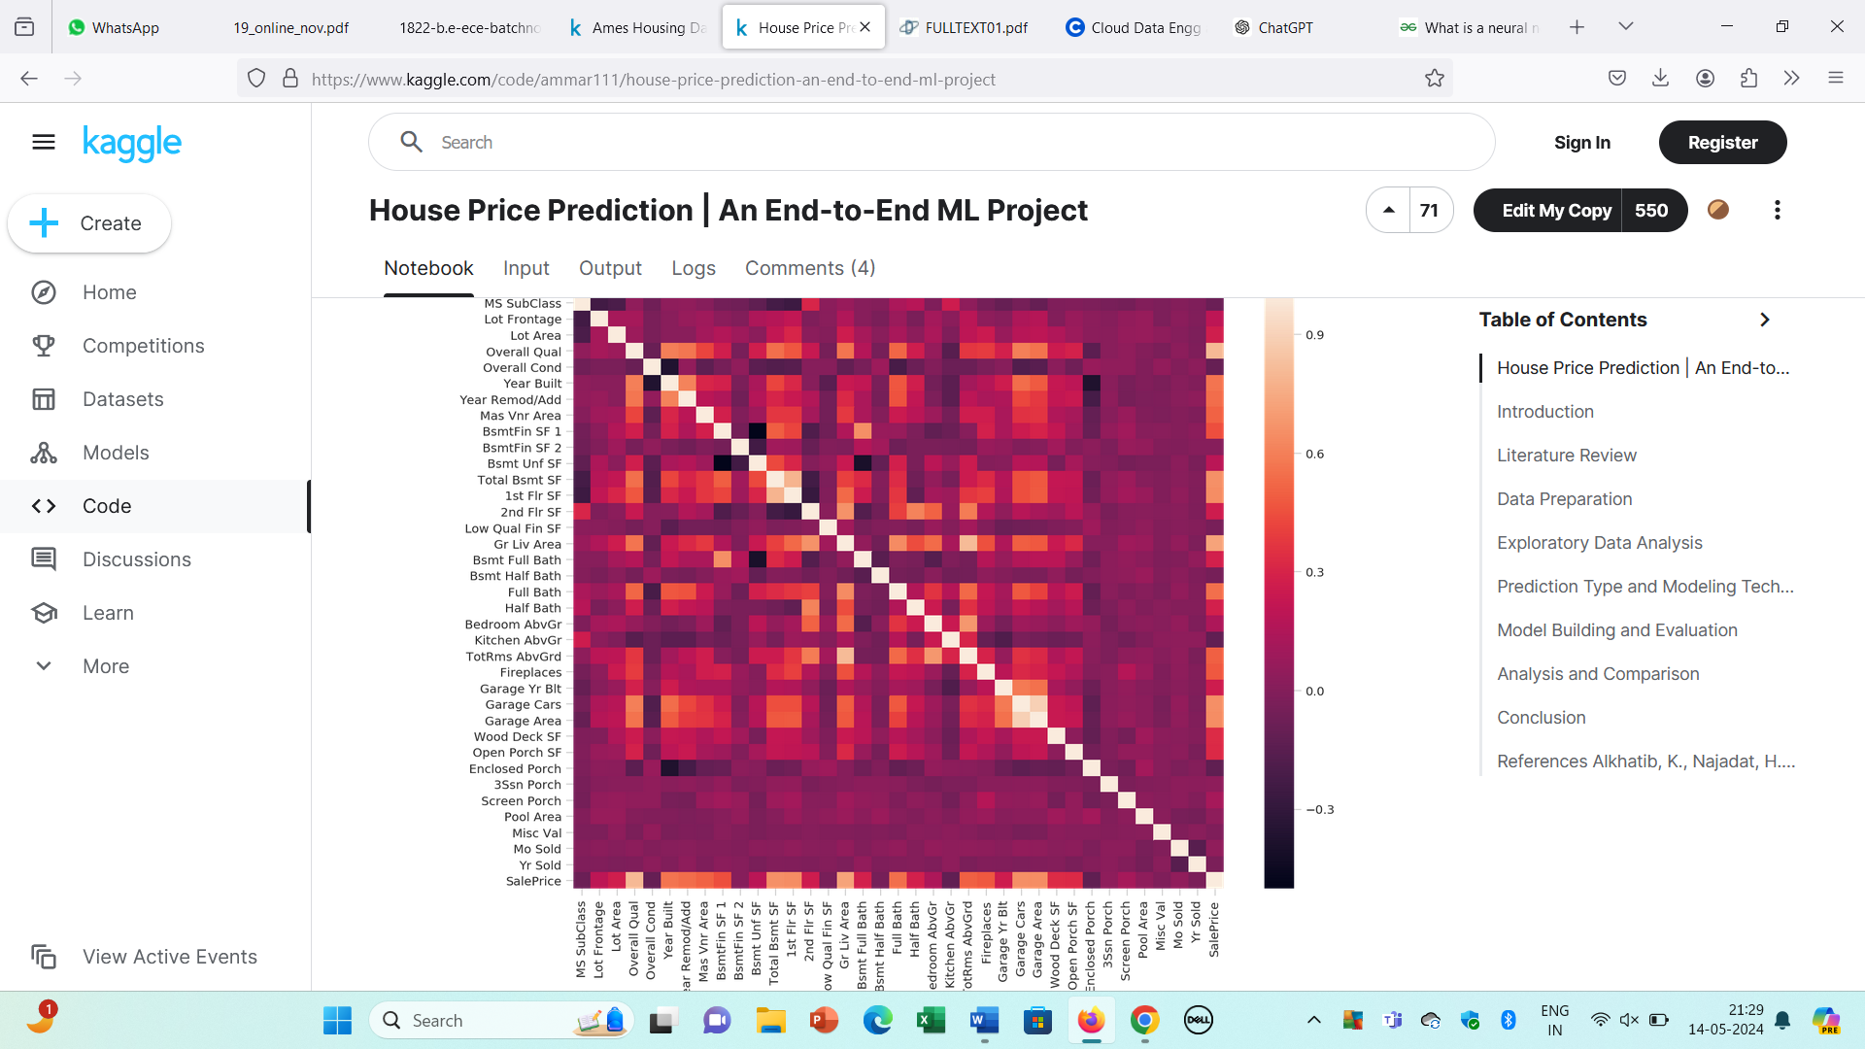
RESULT
Figure : Heatmap

Slide 16
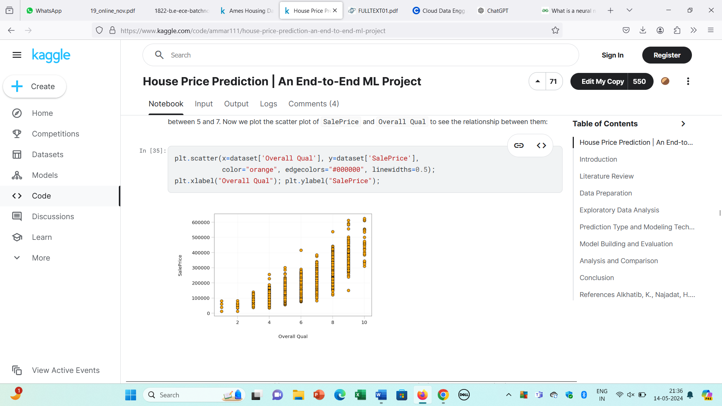
Figure: High Positive Correlation

Slide 17
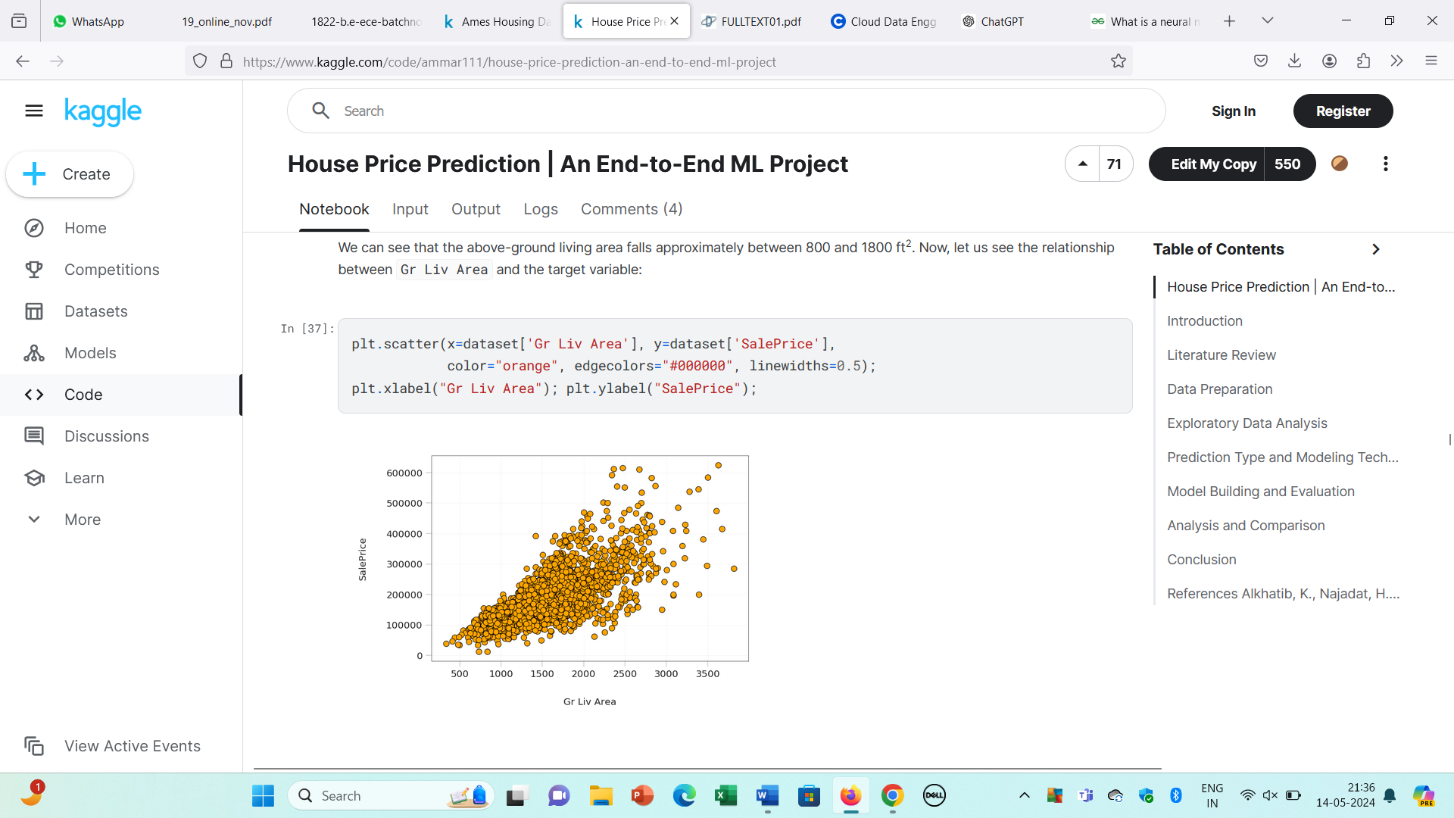
Figure : High Positive Correlation

Slide 18
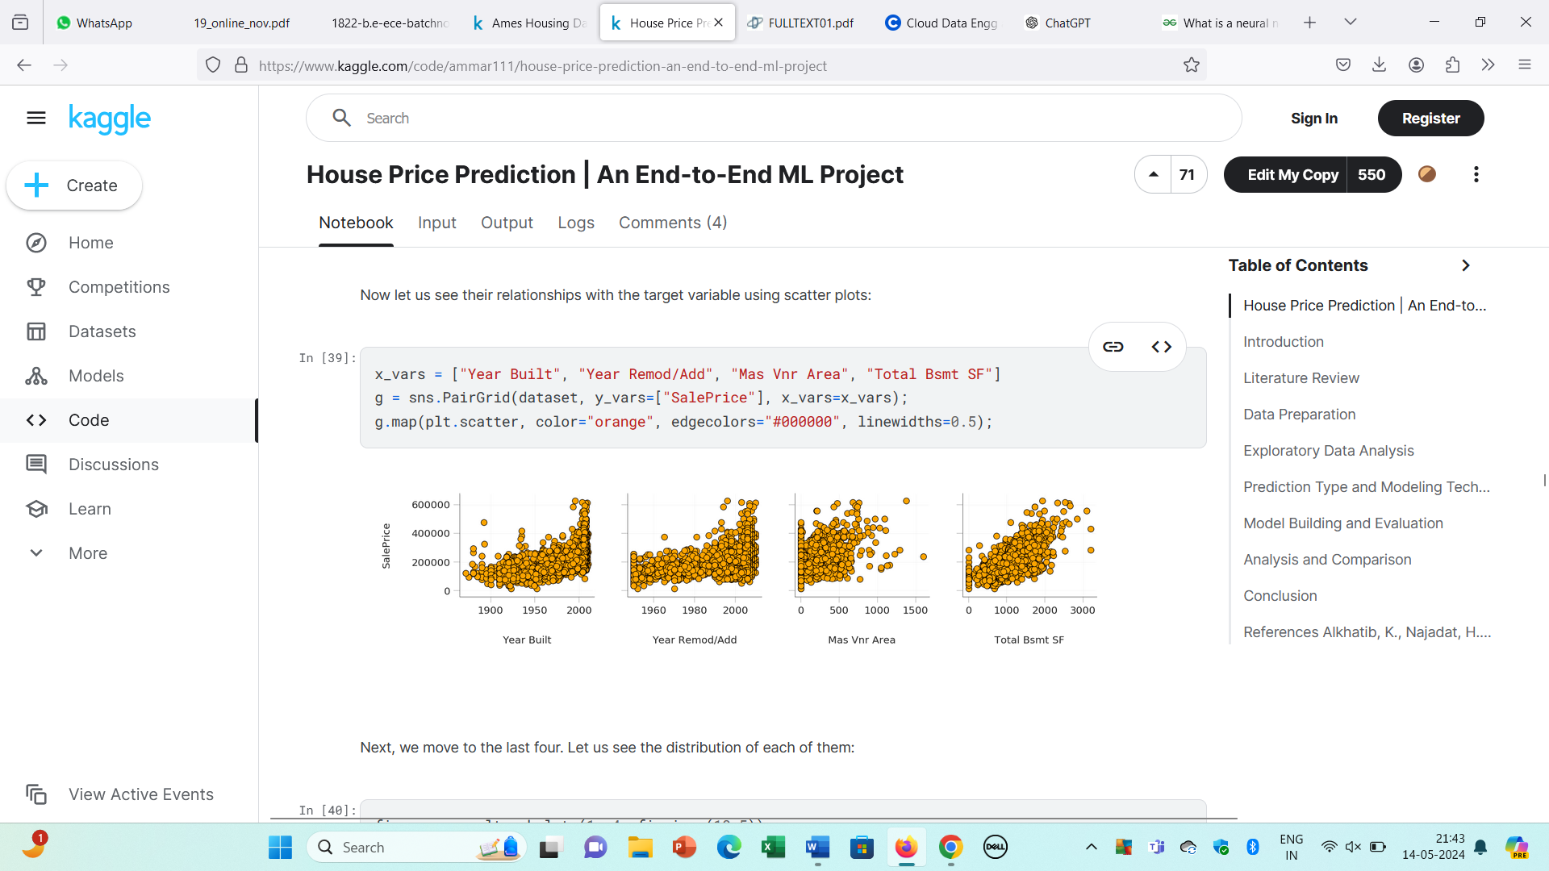
Figure : Moderate Correlation-Year Built, Year Remod, Mas Vnr Area, Total Bsmt SF

Slide 19
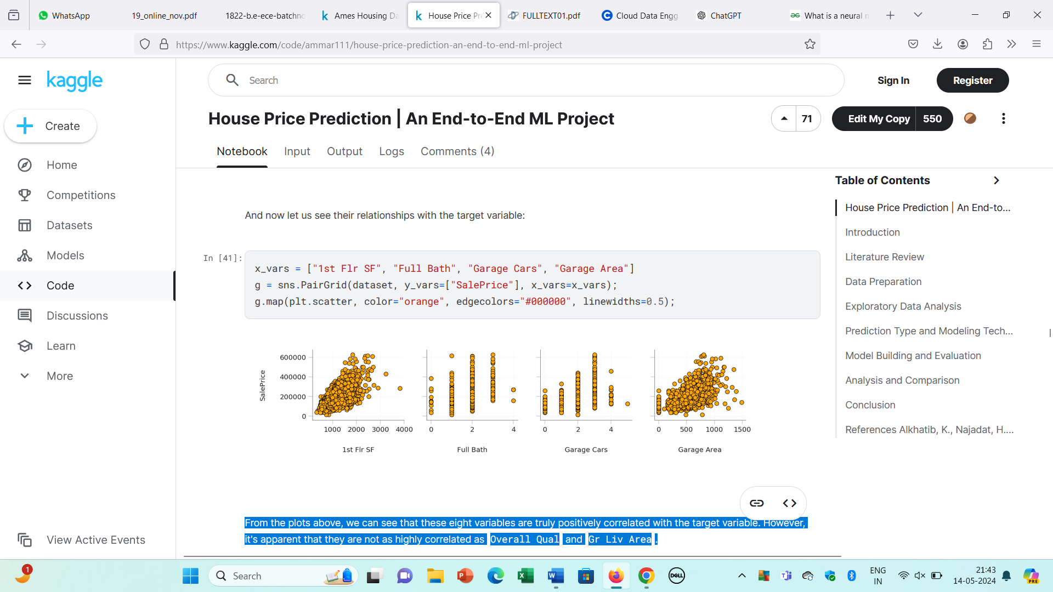
Figure : Moderate Correlation-1st Fir SF, Full Bath, Garage Cars, Garage Area

Slide 20
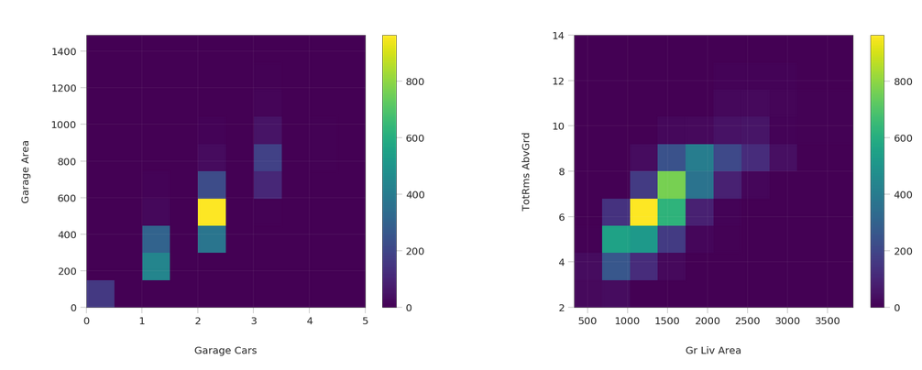
Figure : Positive Correlation

Slide 21
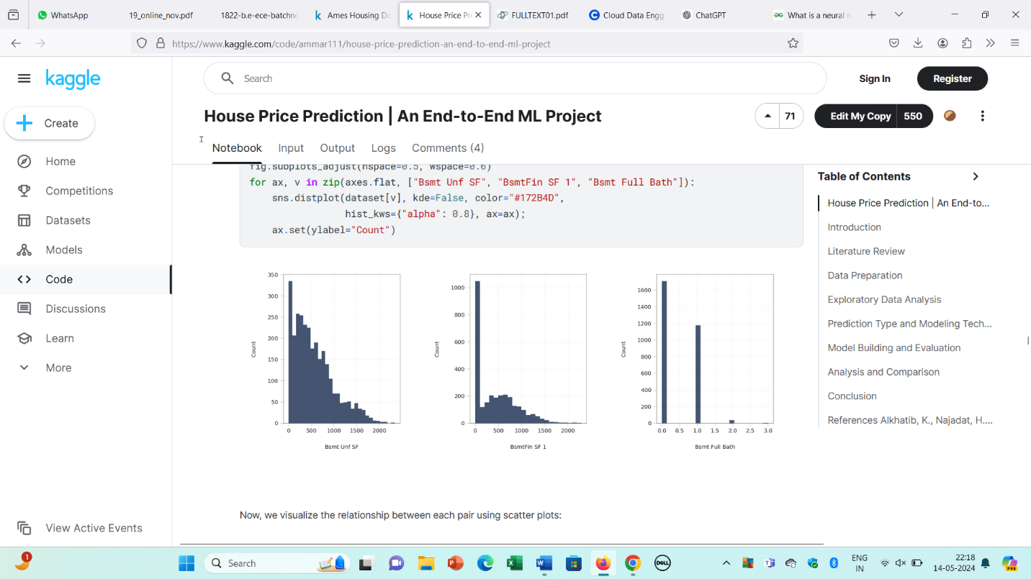
Figure : Distribution of Bsmt Unf SF and BsmtFinSF 1 and Bsmt Full Bath

Slide 22
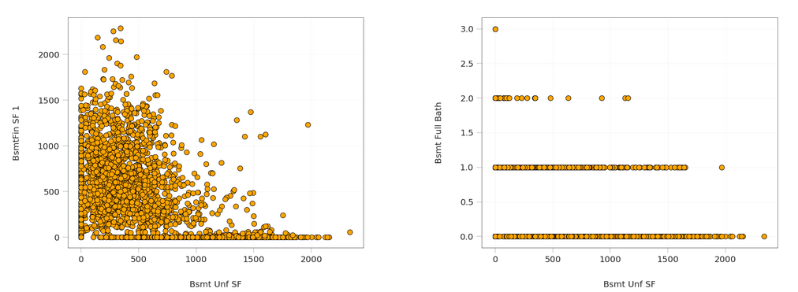
Figure : Negative Correlation

Slide 23
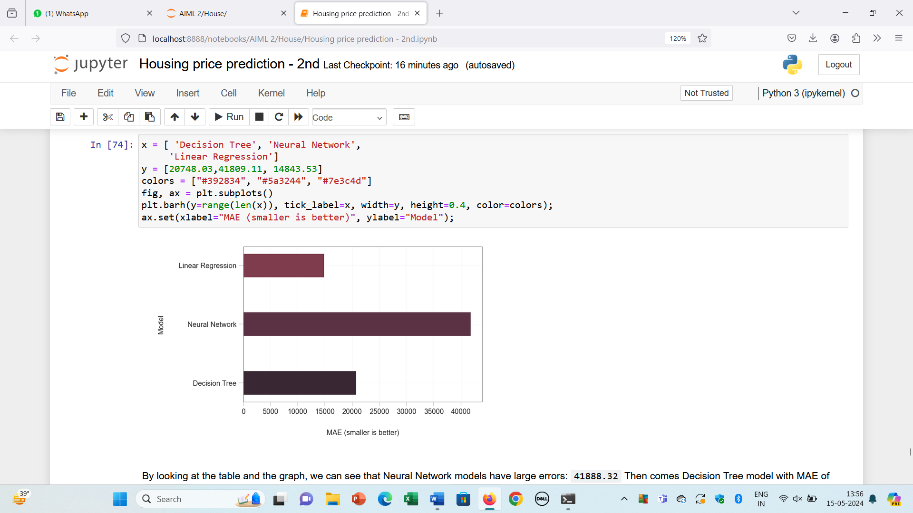
Figure : Neural Network

Slide 24
FUTURE SCOPE
Advanced Algorithms: Implement advanced machine learning algorithms like ensemble methods, deep learning, and reinforcement learning to improve prediction accuracy and capture complex patterns in housing data.
Feature Engineering: Explore sophisticated feature engineering techniques to extract more meaningful insights from the data, including feature selection, creation, and transformation.
Real-Time Prediction: Develop real-time prediction capabilities to provide users with up-to-date insights into housing market dynamics and enable timely decision-making.
Ethical Considerations: Address ethical considerations, including fairness, transparency, and accountability, in model development and deployment to ensure that prediction models do not perpetuate biases or discrimination.
By focusing on these areas, the future scope for house price prediction projects aims to enhance prediction accuracy, interpretability, and user experience, ultimately empowering stakeholders in the real estate industry to make informed decisions and navigate the housing market effectively.

Slide 25
CONCLUSION
In this paper, we built several regression models to predict the price of some house given some of the house features. We evaluated and compared each model to determine the one with highest performance. We also looked at how some models rank the features according to their importance. In this paper, we followed the data science process starting with getting the data, then cleaning and preprocessing the data, followed by exploring the data and building models, then evaluating the results and communicating them with visualizations.

Slide 26
REFERENCE
Alkhatib, K., Najadat, H., Hmeidi, I., & Shatnawi, M. K. A. (2013). Stock price prediction using k-nearest neighbor (kNN) algorithm. International Journal of Business, Humanities and Technology, 3(3), 32-44.
de Abril, I. M., & Sugiyama, M. (2013). Winning the kaggle algorithmic trading challenge with the composition of many models and feature engineering. IEICE transactions on information and systems, 96(3), 742-745.
Feng, Y., & Jones, K. (2015, July). Comparing multilevel modelling and artificial neural networks in house price prediction. In Spatial Data Mining and Geographical Knowledge Services (ICSDM), 2015 2nd IEEE International Conference on (pp. 108-114). IEEE.
Hegazy, O., Soliman, O. S., & Salam, M. A. (2014). A machine learning model for stock market prediction. arXiv preprint arXiv:1402.7351.
Ticknor, J. L. (2013). A Bayesian regularized artificial neural network for stock market forecasting. Expert Systems with Applications, 40(14), 5501-5506.
De Cock, D. (2011). Ames, Iowa: Alternative to the Boston housing data as an end of semester regression project. Journal of Statistics Education, 19(3).

Slide 27


